Slide 1
Digital Stress and Mental Health Across Time Among Peruvian Adolescents
Daniela E. Muñoz Lopez

Slide 2
Background

Slide 3
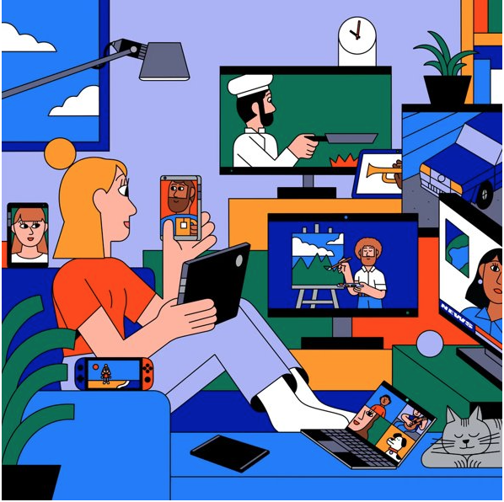
Adolescents and Digital Media Use
Adolescence is a critical developmental period characterized by social and emotional learning that shapes identity development
For adolescents, being online has allowed for more sociability & connectivity opportunities
Online only friendships
During adolescence there is a lot of
Attention to social sensitivity
Concern with what others think about you
Magis-Weinberg et al., 2021; Nelson et al., 2016; Nielson et al., in prep; Reid Chassiakos et al., 2016
Notes:
For this study, I was interested in exploring digital stress among adolescents for various reasons….
After concern: CONNECT TO DSS → SO, IF MANAGING FEELINGS OF DSS IS HARD FOR US, IMAGINE HOW AMPLIFIED THIS IS FOR ADOLESCENCE WHO ARE GOING THROUGH VARIOUS DEVELOPMENTAL TASKS
We know there is a dependency on tech for connection

Slide 4
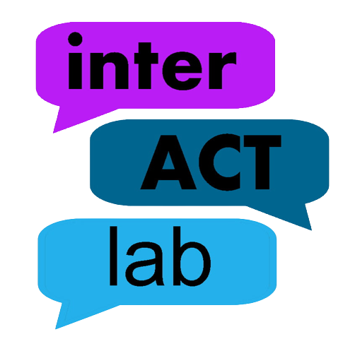
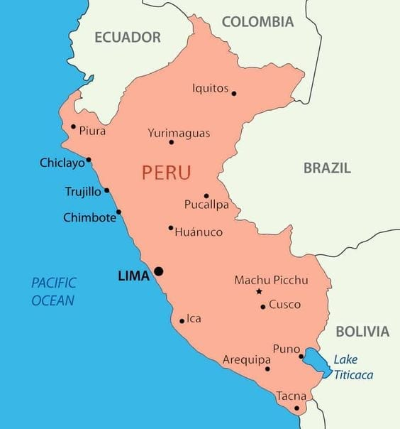
Digital Media Use and COVID-19 for Adolescents in Perú
Little research on the frequency and intensity of digital media use in the global south
Most studies focus on general device access and digital skills while fewer studies explore the relationship between digital media use and wellbeing
Stringent lockdown in Perú
Two full years of remote instruction
Data has shown effects of COVID-19 on adolescents in Peru
Ghai et al., 2022; Magis-Weinberg et al., 2021; Magis-Weinberg et al., under review; Matassi & Boczkowski, 2020; Nelson et al., 2016
Notes:
In the interACT lab, we are interested in capturing the experienced of youth growing up in the majority world, or the global south, specifically Latin America because…
***Perú, positive experiences with SMU (e.g., getting help online) were associated with less loneliness during the pandemic, with reverse patterns for the negative experiences with SMU
Before stringent lockdown
- FOMO and social networking intensity mediates the association between mental health symptoms and negative online consequences

Slide 5
Cross-Sectional Study
Digital Stress
Perceived Stress
Symptoms of Anxiety
Symptoms of Depression
Peruvian Adolescents during COVID-19

Slide 6

Digital Stress
Connection overload
Fear of Missing Out (FOMO)
Availability Stress
Approval Anxiety
Online Vigilance
Steele et al. 2020; Hall et al. 2021
Notes:
If you have felt any of these things, you have endorsed subjective ratings of digital stress.
Digital Stress is a subjective experience characterized by a person’s own response to distressing events occurring online.
These numerous facets of digital stress may be playing a role in the association between social media use & psychological outcomes among adolescents.

Slide 7
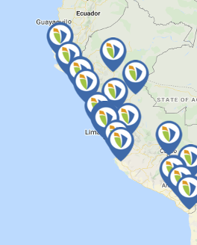
Methods
Collected data during week 68 of lockdown in Perú: June 28th, 2021
Collected self-report data on perceived stress, symptoms of anxiety, and symptoms of depression
Administered the Digital Stress Scale (DSS; Hall et al. 2020)
Culturally adapted
Validated this using EFA & CFA
Ran linear models to explore associations between variables of interest
Notes:
64 schools
add visual explaining the adaptation of the culturally adapted scale – TO DO
Re-arrange
Data collected during
Type of data collected
Analyses
Efa/CFA
LM

Slide 8
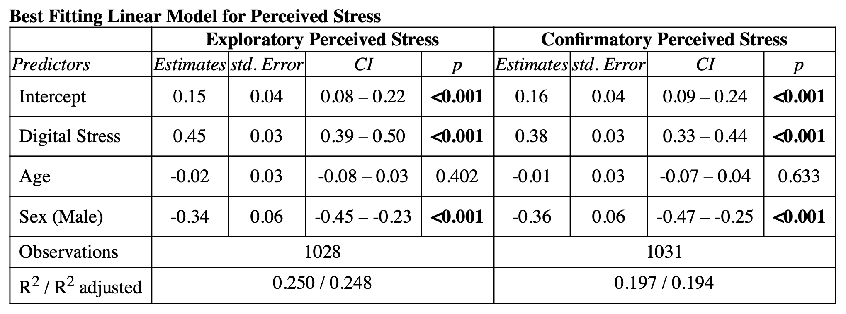
Digital stress is associated with higher perceived stress

Slide 9
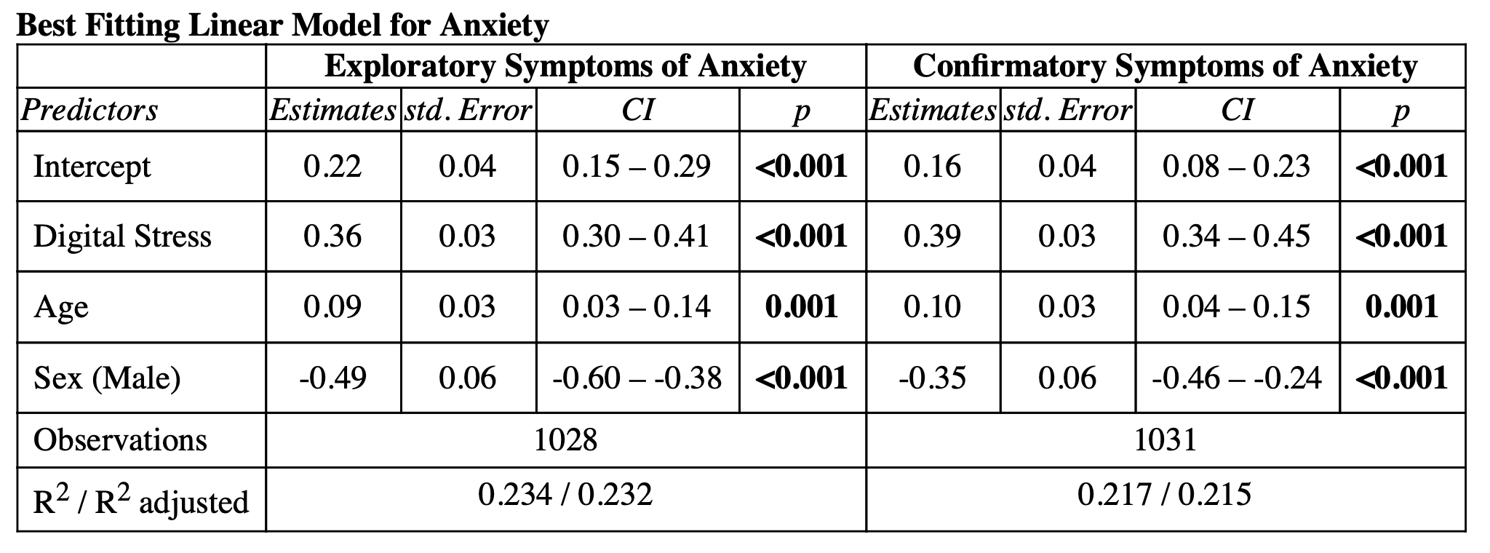
Digital stress is associated with higher symptoms of anxiety

Slide 10
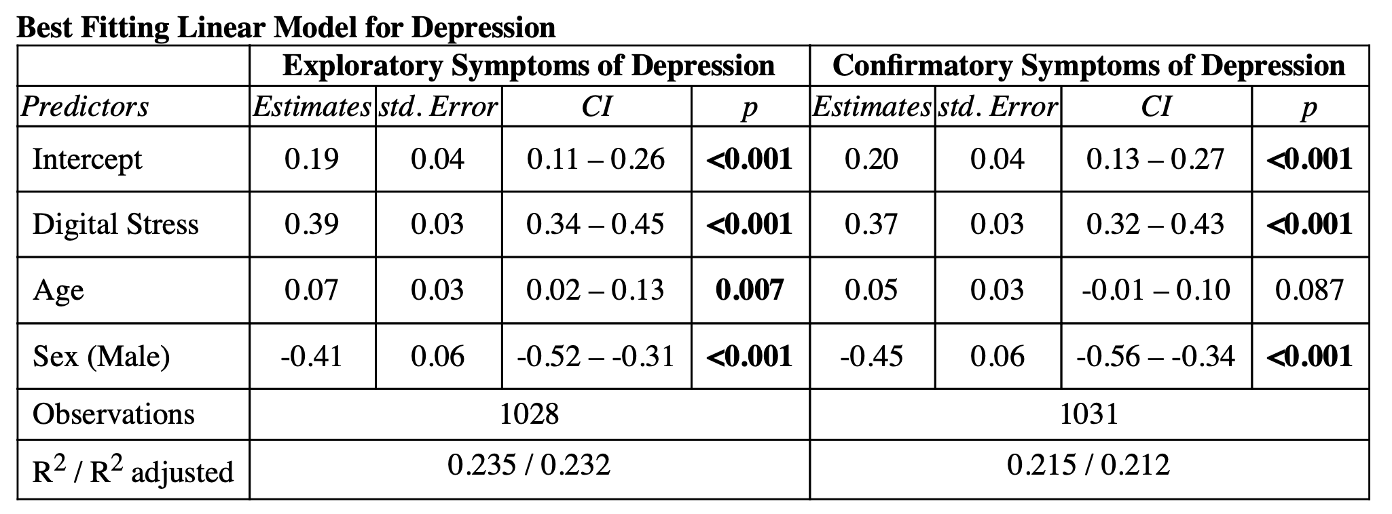
Digital stress is associated with higher symptoms of depression

Slide 11

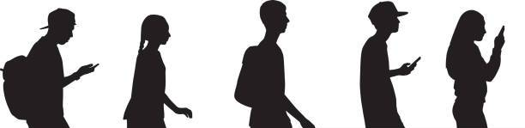
Adolescent girls & older adolescents endorsed more digital stress, perceived stress, and symptoms of anxiety & depression
Notes:
Adolescent girls and older adolescents endorse more digital stress
This is related to symptoms of stress, anxiety, and depression.
- include better transition next

Slide 12
The Current Study

Slide 13
Digital Stress and Mental Health Across Time: A Longitudinal Follow Up
We aimed to explore:
1. If digital stress increased from Time 1 (June 2021) to Time 2 (November 2021)
2. If baseline mental health vulnerabilities (anxiety and depression) at Time 1 predict increases in digital stress at Time 2

Slide 14
Methods
Collected data during week 68 of lockdown in Perú: June 28th, 2021
Additional data from week 87 of lockdown in Perú: November 8th, 2021
Administered the Digital Stress Scale (DSS; Hall et al. 2020)
Culturally adapted
Administered PROMIS Anxiety & PROMIS Depression
Mixed-effect models to explore associations between variables of interest
Notes:
64 schools
add visual explaining the adaptation of the culturally adapted scale – TO DO
Re-arrange
Data collected during
Type of data collected
Analyses
Efa/CFA
LM

Slide 15
Sample Characteristics
N = 973
Time 1 N = 496
Time 2 N = 477
64.2% female
Ages 11 – 17 (Mean: 12.8; SD 1.5)

Slide 16
Digital Stress
Digital Stress (18 items)
Likert Scale: 1-5
Average items to create mean score
Peru 5 DSS score mean: 2.12
Peru 6 DSS score mean: 2.06

Slide 17
Anxiety & Depression
PROMIS Anxiety (4 items)
Likert Scale: 1-5
Sum items to create a sum score
Raw score converted to T-Scores
T-Scores > 59 are considered “clinical”
PROMIS Depression (8 items)
Likert Scale: 1-5
Sum items to create a sum score
Raw score converted to T-Scores
T-Scores > 53 are considered “clinical”
Chang et al. (2023)

Slide 18
Severity Ranking
Depression | N | %
Clinical | 649 | 66.7%
Non-clinical | 324 | 33.3%
Anxiety | N | %
Clinical | 604 | 62.08%
Non-clinical | 369 | 37.92%
Notes:
Total n = 1439

Slide 19
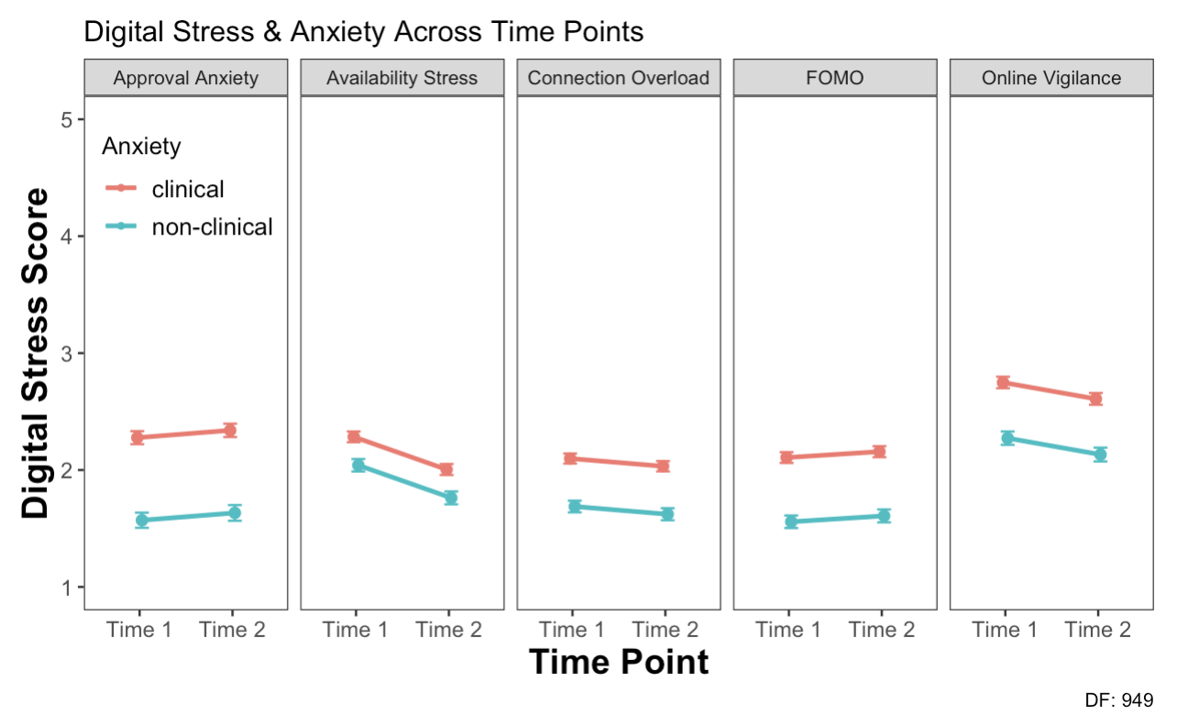
Digital stress was higher for those with “clinical” anxiety

Slide 20
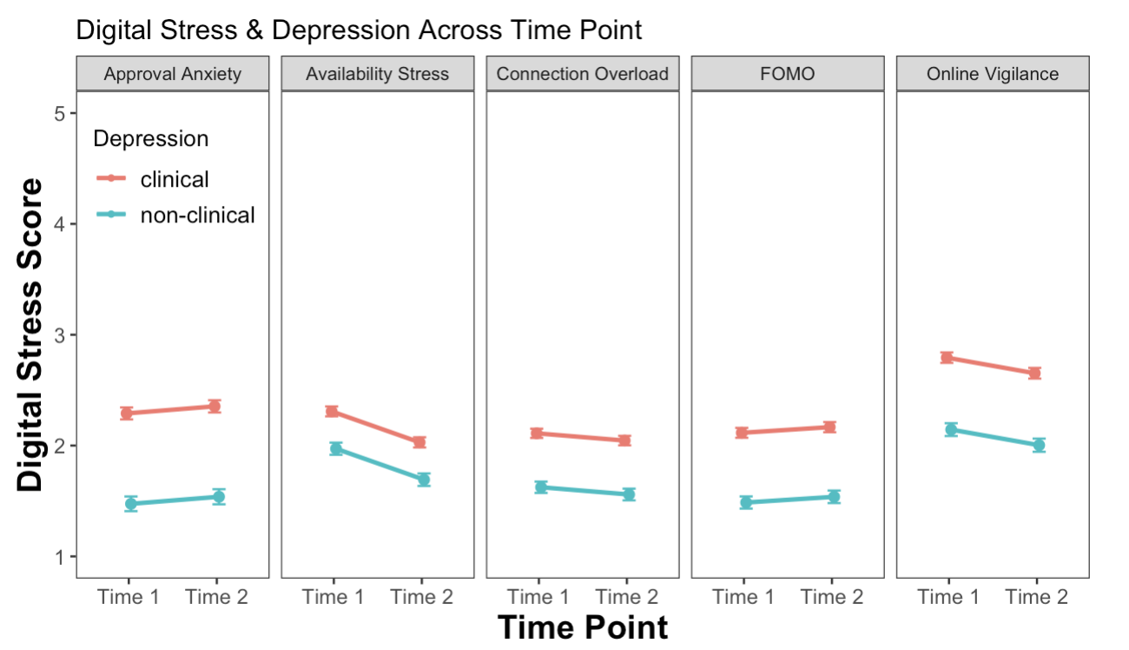
Digital stress was higher for those with “clinical” depression

Slide 21
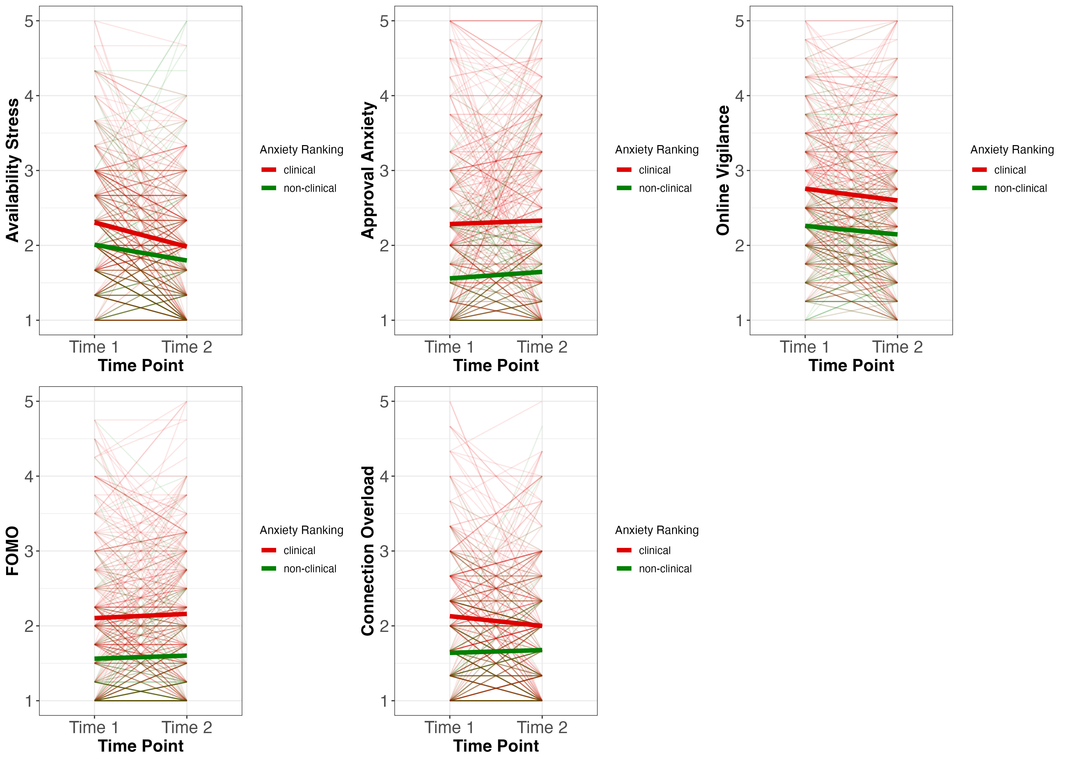
Main effect of anxiety ranking
Notes:
Main effect of anxiety ranking: those who were non-clinical have lower DSS ranking
Main effect of wave for some: DSS was higher at time 2 for some (AS, OV only)

Slide 22
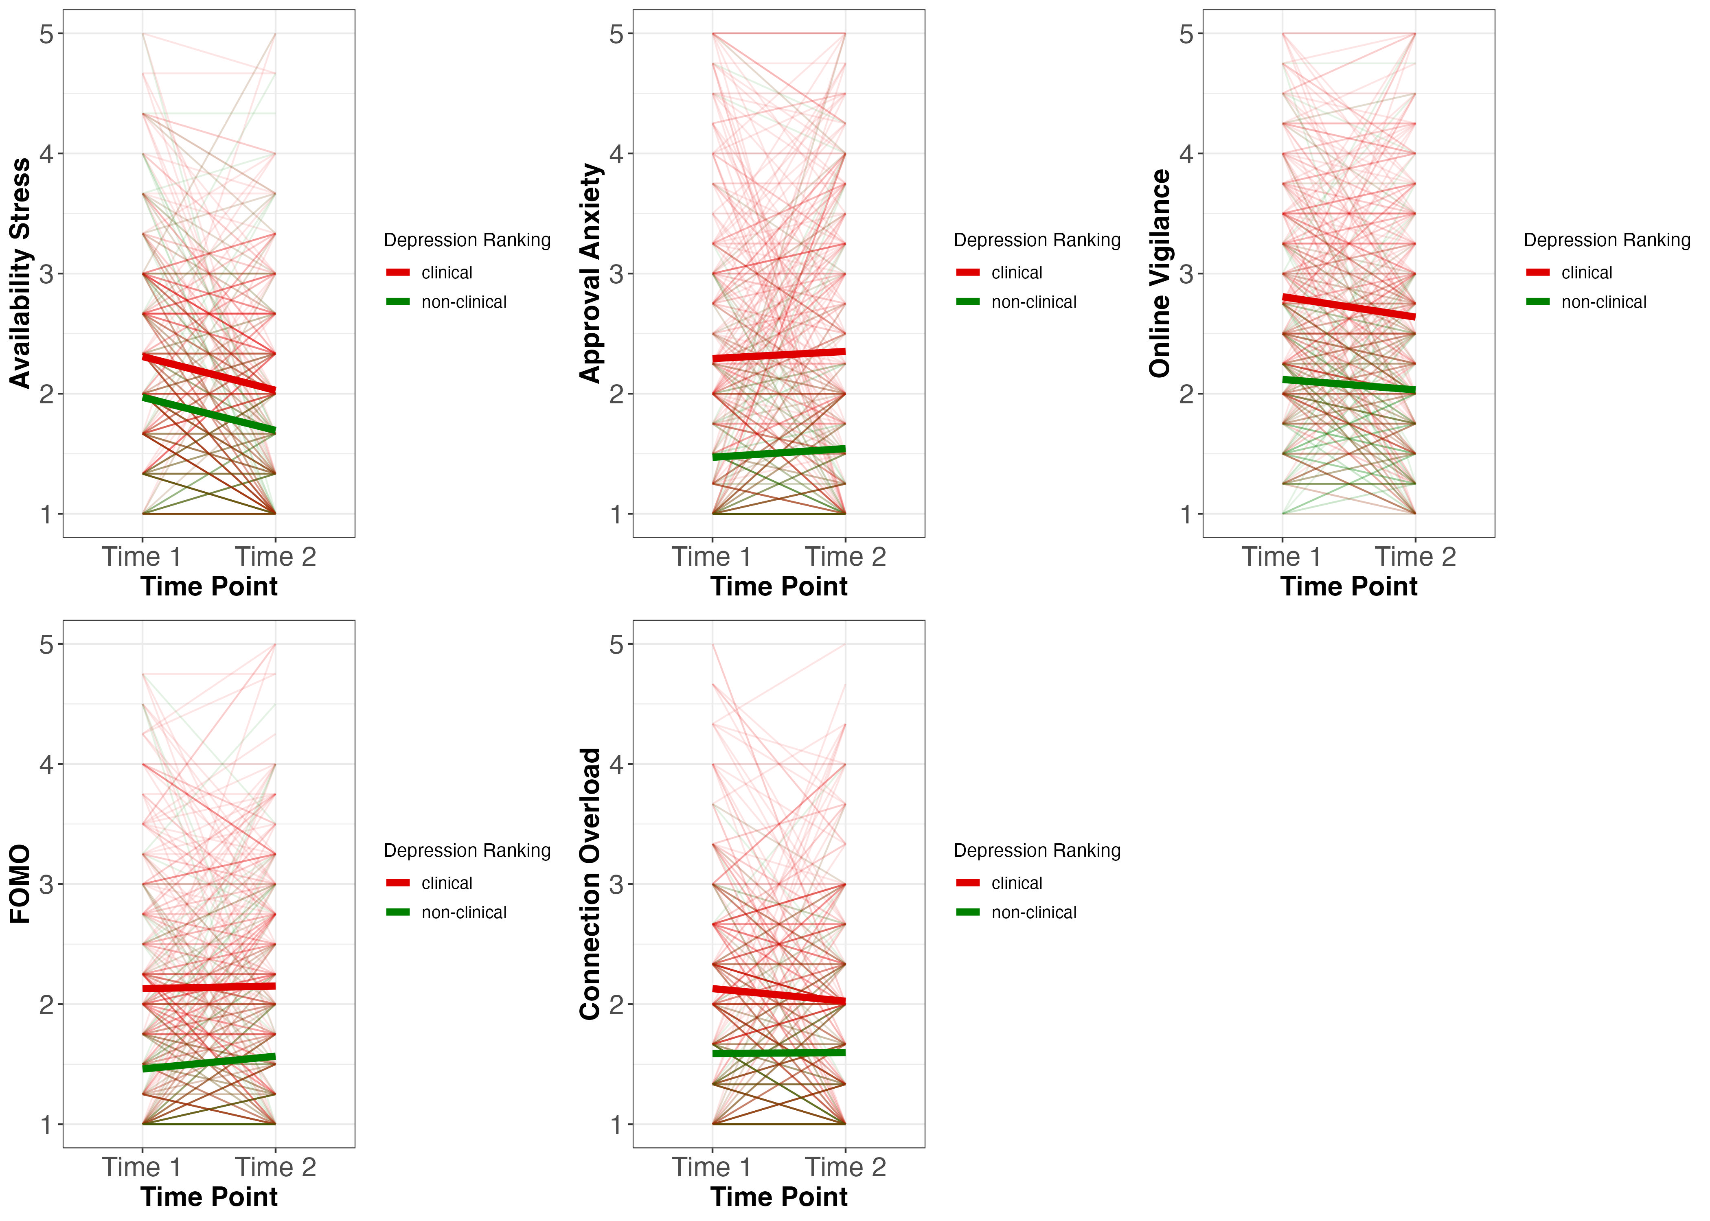
Main effect of depression ranking
Notes:
Main effect of anxiety ranking: those who were non-clinical have lower DSS ranking
Main effect of wave for some: DSS was higher at time 2 for some (AS, OV only)

Slide 23
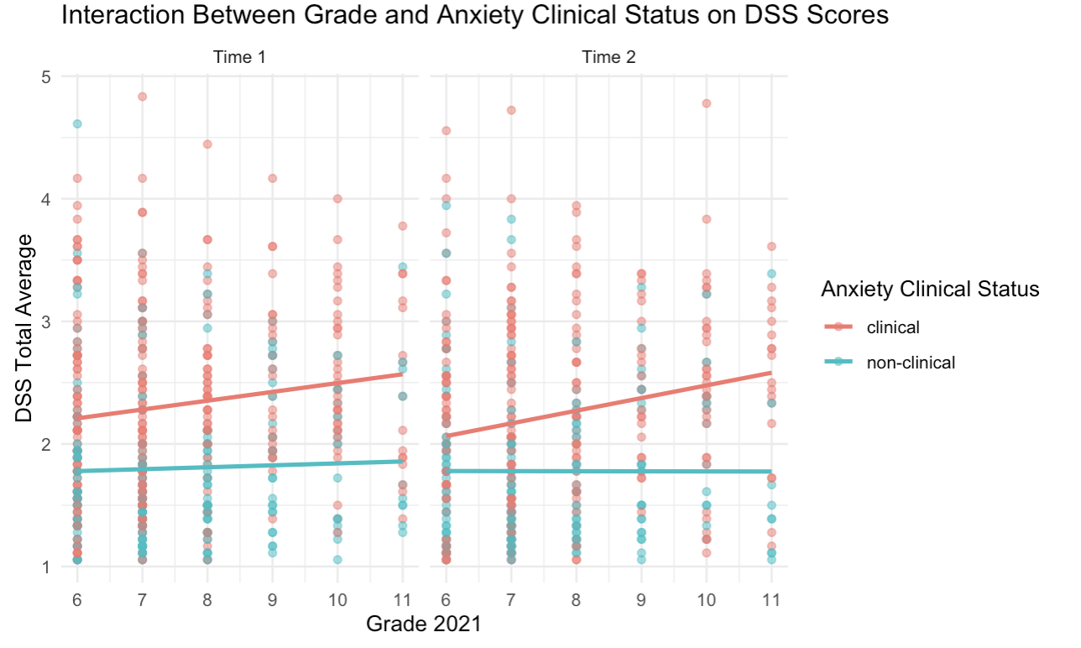
Digital stress was higher for older adolescents who had ”clinical” anxiety at Time 1
Notes:
Interaction: effect of grade on DSS is similar for clinical & non-clinical anxiety -- As grade increases, DSS increases more for those with baseline clinical anxiety

Slide 24
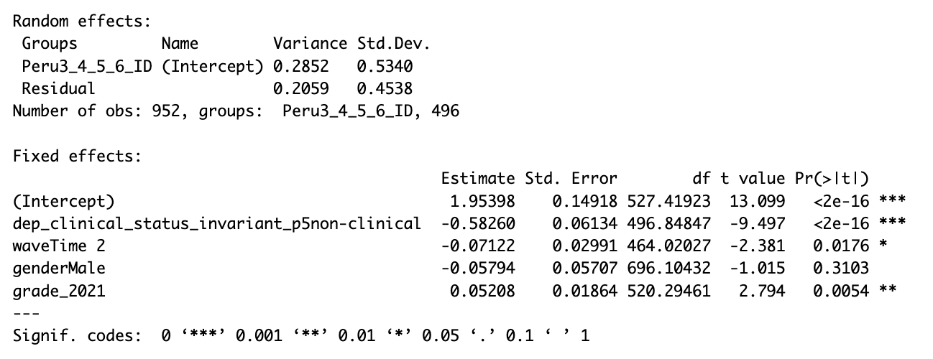
Digital stress was lower at Time 2
Notes:
No interaction between time and depression ranking

Slide 25
Summary
Digital stress was higher for those who reported clinical levels of anxiety and depression
We found a main effect of anxiety and depression ranking, but no main effect of time
We found an interaction between grade and clinical anxiety: digital stress was higher for older adolescents who endorsed “clinical” anxiety at Time 1
Digital stress was lower at Time 2
No interactions between time and clinical depression ranking

Slide 26
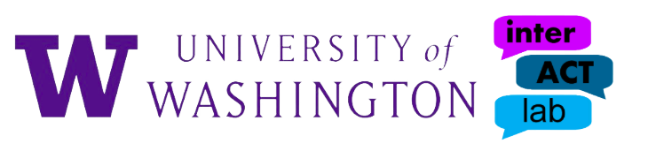
Notes:
need overlap with models to test anova
anx and dep clinical time 2
- look at comorbidities
what went into the t-score conversions?
- could this be explaining why we see differences?

